Slide 1
CSE 423: Embedded Systems
Lecture: 3
Intro to the Arduino Sketch
Topics:
Serial Communication
Loop
Function
Notes:
CSE423@DiU, Spring'2017

Slide 2
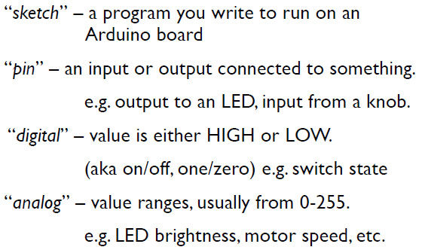
Terminology
CSE423@DiU, Summer 2019
Notes:
CSE423@DiU, Spring'2017

Slide 3
Arduino Timing
delay(ms)
  Pauses for a few milliseconds
delayMicroseconds(us)
  Pauses for a few microseconds
CSE423@DiU, Summer 2019

Slide 4
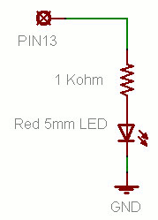
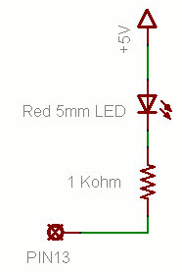
Putting It Together
Complete the sketch (program) below.
What output will be generated by this program?
What if the schematic were changed? ➔
CSE423@DiU, Summer 2019

Slide 5
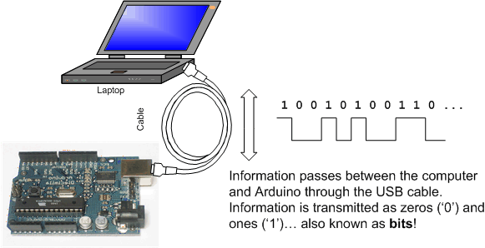
Serial Communication
CSE423@DiU, Summer 2019

Slide 6
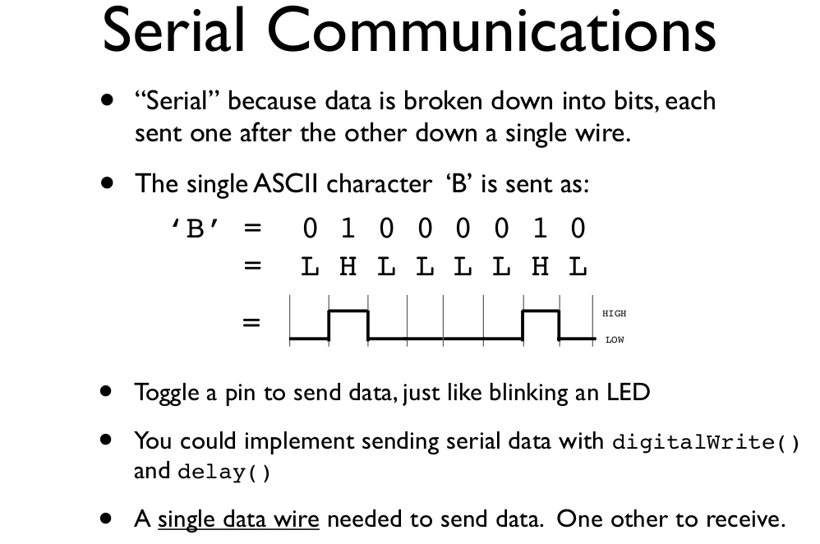
CSE423@DiU, Summer 2019
todbot.com/blog/bionicarduino

Slide 7
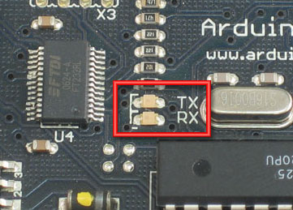
Serial Communication
Compiling turns your program into binary data (ones and zeros)
Uploading sends the bits through USB cable to the Arduino
The two LEDs near the USB connector blink when data is transmitted
  RX blinks when the Arduino is receiving data
  TX blinks when the Arduino is transmitting data
CSE423@DiU, Summer 2019

Slide 8
First Program
void setup( ) // run once, when the sketch starts
{
Serial.begin(9600); // set up Serial library at 9600 bps
Serial.println("Hello world!"); // prints hello with a line break
}
void loop( ) // run over and over again
{ // do nothing!
}
CSE423@DiU, Summer 2019

Slide 9
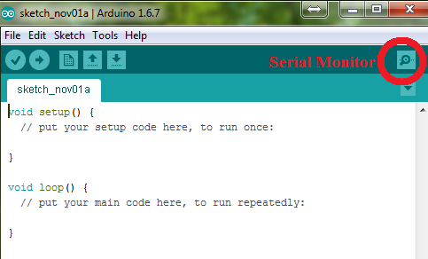
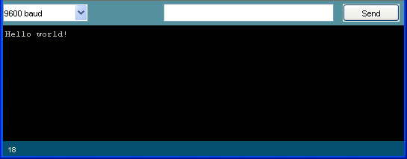
Open the Serial Monitor and Upload the Program
CSE423@DiU, Summer 2019

Slide 10

Modify the Program (each bullet is a different mod)
Move Serial.println("Hello world!"); to loop()
Add the following to setup():
  int a = 5;
  int b = 10;
  Serial.print("a + b = ");
  Serial.println(a + b);
Replace the code above with the following:
CSE423@DiU, Summer 2019

Slide 11
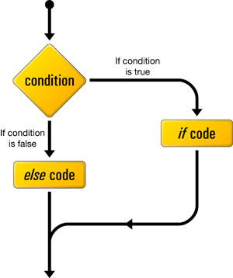
Conditional Statement
if (some Condition)
{
// do stuff if the condition is true
}
else
{
// do stuff if the condition is false
}
CSE423@DiU, Summer 2019

Slide 12
Conditional Statement
int printMessage = 1;
void setup()
{ Serial.begin(9600);
}
void loop()
{
if (printMessage == 1)
{
Serial.println("Message");
printMessage= 0;
}
else {
Serial.println("NO Message");
printMessage= 1;
}
}
int printMessage = 1;
void setup()
{ Serial.begin(9600);
}
void loop()
{
if (printMessage == 1) {
Serial.println("Message");
printMessage= 0;
}
}
CSE423@DiU, Summer 2019

Slide 13
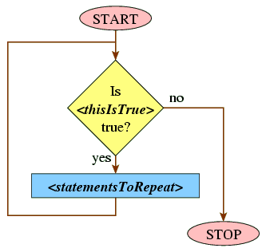
while Loop
while(expression)
{
statement(s);
}
Example
int var = 0;
while (var < 200) {
// do something repetitive 200 times
var = var + 1;
}
CSE423@DiU, Summer 2019

Slide 14
while Loop
void setup()
{ Serial.begin(9600);
int count = 0;
while (count < 5) {
Serial.println("Hello world!");
count = count +1;
}
}
void loop()
{
}
CSE423@DiU, Summer 2019

Slide 15
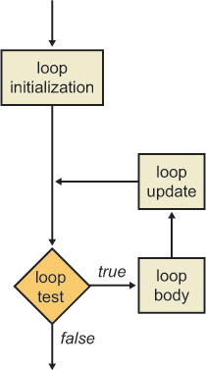
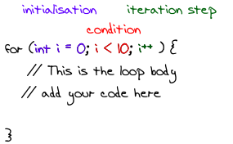
for loop
CSE423@DiU, Summer 2019

Slide 16
for Loop
void setup()
{
Serial.begin(9600);
for (int count = 0; count < 5; count++) {
Serial.println("Hello world!");
}
}
void loop()
{
}
CSE423@DiU, Summer 2019

Slide 17
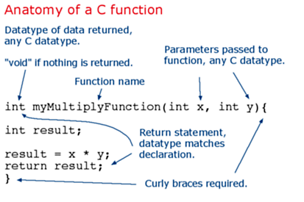
Functions
loop() and setup() are procedures
You can create you own functions
void setup()
{
}
void loop()
{
}
Both setup() and loop()
have no parameters and
return no values
CSE423@DiU, Summer 2019

Slide 18
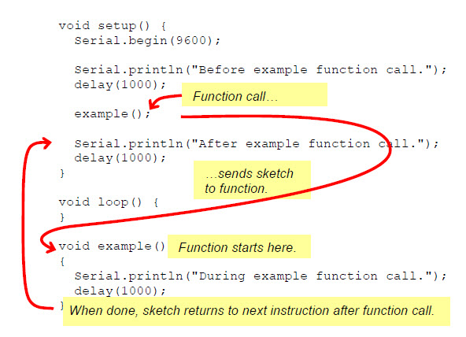
Functions: Example 1
CSE423@DiU, Summer 2019

Slide 19
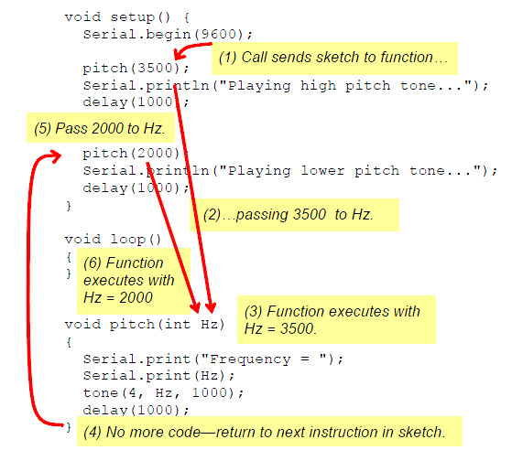
Functions: Example 2
CSE423@DiU, Summer 2019

